Slide 1
Analysis of the Restaurant Market in South Mumbai
Coursera Capstone Project
By V R Shah

Slide 2
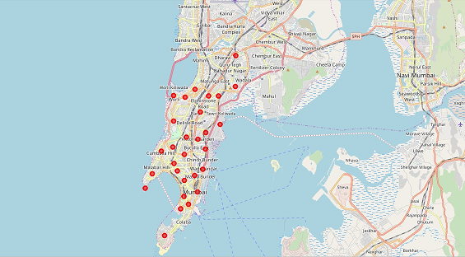
Introduction
Mumbai is the financial, commercial and entertainment capital of India and also one of the world's top ten hubs of commerce.
“South Mumbai “is the Mumbai
City district comprises the city's
main business localities, making
it the wealthiest urban precinct
in India and the world.
Problem Statement:
If we are to consider an business
or investment opportunity to
open or expand a restaurant in
South Mumbai then,
What is an optimum location in a budget?
Which kind of restaurant service?

Slide 3
Data Gathered
To choose a right location and serving type, effective data analysis is essential. Data we collected are:
1. Property rate of different location (rent / purchase)
2. Demography of different location
3. Restaurants and their types in different locations
4. Cuisine type served by competitors or restaurants
Etc.

Slide 4
Methodology
Data Cleaning
Data Filtering
Data Transformation
Data Visualization and Analysis
Clustering

Slide 5
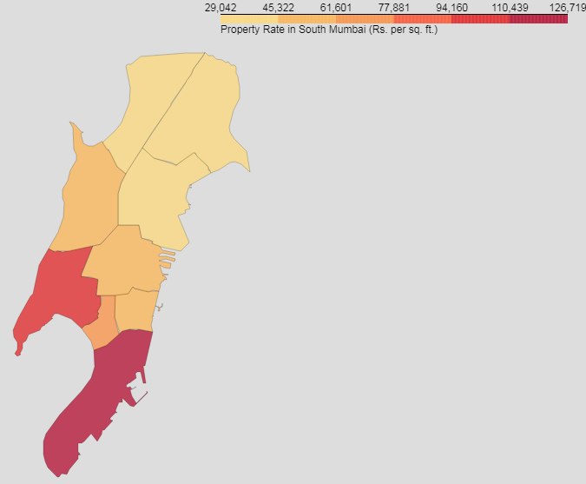
Property Map of South Mumbai
For Buy or
Rent
Restaurant
Space
Given
Property rate
in Map is for
buying

Slide 6
Top 5 Costliest Property Area of South Mumbai
Area | Avg. Price (Rs. Per Sq. Ft.)
Asvini , Colaba , Colaba Bazar , Holiday Camp , V.W.T.C. | 68817
New Prabhadevi Road , Prabhadevi | 84831
Cumballa Hill , Cumballa Sea Face , Dr Deshmukh Marg , Gowalia Tank | 94247
Nariman Point , New Yogakshema | 109457
Malabar Hill | 125761
Rajbhavan (Mumbai) | 125761

Slide 7
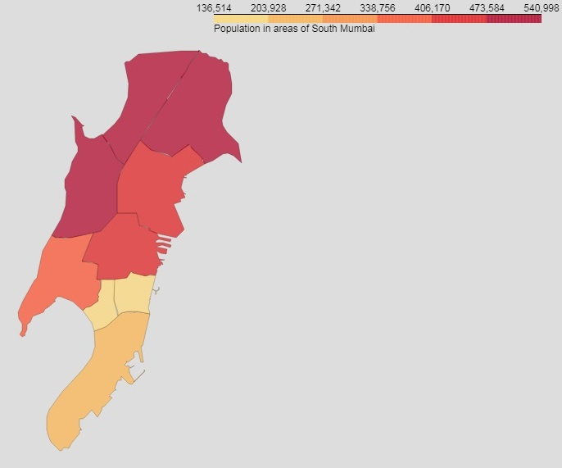
Population Density of South Mumbai
Factors:
More
Customers
Faster
Growth Rate

Slide 8
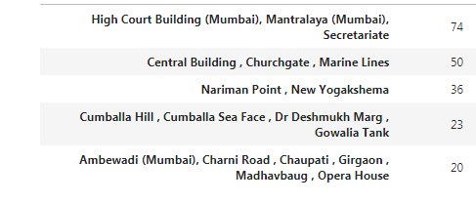
Top 5 regions of South Mumbai with Highest Number of Restaurants

Slide 9
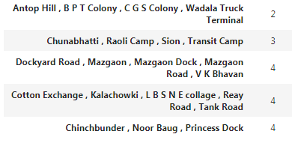
'Top 5 regions of South Mumbai with Lowest Number of Restaurants'

Slide 10
Types of Restaurant Service
American Restaurant
Asian Restaurant
BBQ Joint
Bakery
Bar
Bengali Restaurant
Café
Chaat Place
Cheese Shop
Chinese Restaurant
Cocktail Bar
Coffee Shop
Cupcake Shop
Deli / Bodega
Dessert Shop
Diner
Donut Shop
Fast Food Restaurant
French Restaurant
Fried Chicken Joint
Hotel Bar
Ice Cream Shop
Indian Restaurant
Irani Cafe
Italian Restaurant
Japanese Restaurant
Juice Bar
Lounge
Mediterranean Restaurant
Middle Eastern Restaurant
Multicuisine Indian Restaurant
Pizza Place
Pub
Restaurant
Seafood Restaurant
Snack Place
Tea Room
Vegetarian / Vegan Restaurant

Slide 11
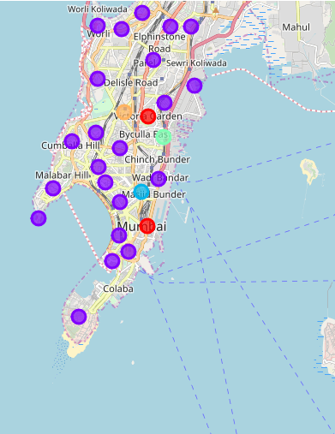
Most Popular Restaurant Food Type in South Mumbai
Indian Restaurant, i.e.
restaurant that serves
Indian Cuisine are most
popular in the majority
part of South Mumbai.

Slide 12
Top of 5 Restaurant Type in South Mumbai
Indian Restaurant - 47
Café - 29
Fast Food Restaurant - 20
Chinese Restaurant - 17
Bakery – 15
Note: In India, Bakery and Cake shop etc also provide fast food kind of service in India. Their menu also contains items like burger, pizza, puff and some Indian fast foods like
samosa, vadapav etc.

Slide 13
Top of QSR Franchises in South Mumbai
Café Coffee Day - 13
Subway - 8
Domino’s - 5
McDonald’s - 3
Monginis - 3
Baskin – Robbins – 3

Slide 14
Result
Most Popular Food in Restaurant is “Indian”.
Most saturated restaurant business area are Nariman Point, Marine Lines, Chaupati, Cumballa Hill, Gowalia Tank, Opera House, Girgaon etc.
Apart from Indian dishes other popular food items are
1. Fast Foods
Burgers, Vadapav, Pizza, Samosa
2. Chinese Dishes
Least saturated restaurant business area are Antop Hill, Chunabhatti, Mazagaon, Reay Road, Chinchbunder, Dockyard Road, Cotton Exchange etc.

Slide 15
Discussion
Analysis is performed on limited data set.
Re-run analysis with updated information.
Home delivery option for restaurant is also gaining momentum due to food apps like Zomato, Foodpanda, Swiggy so location connectivity is also important
Property price is variable even for the same location.

Slide 16
Conclusion
Analysis is performed on limited data set gathered from “Foursquare”
Re-run analysis with updated information for better approach.
Marine Lines and Nariman Point etc has high concentration of restaurant business . Wadala and Sion has good number of restaurants but not as many to count to saturated.
For restaurant type it is mentioned that Indian Restaurant is preferred one however saturation and competition needed to identify for a preferred venues.

Slide 17
Thank you

